Slide 1
Refraction
Year 9

Slide 2
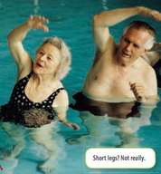
Why do our legs look short in the pool?

Slide 3
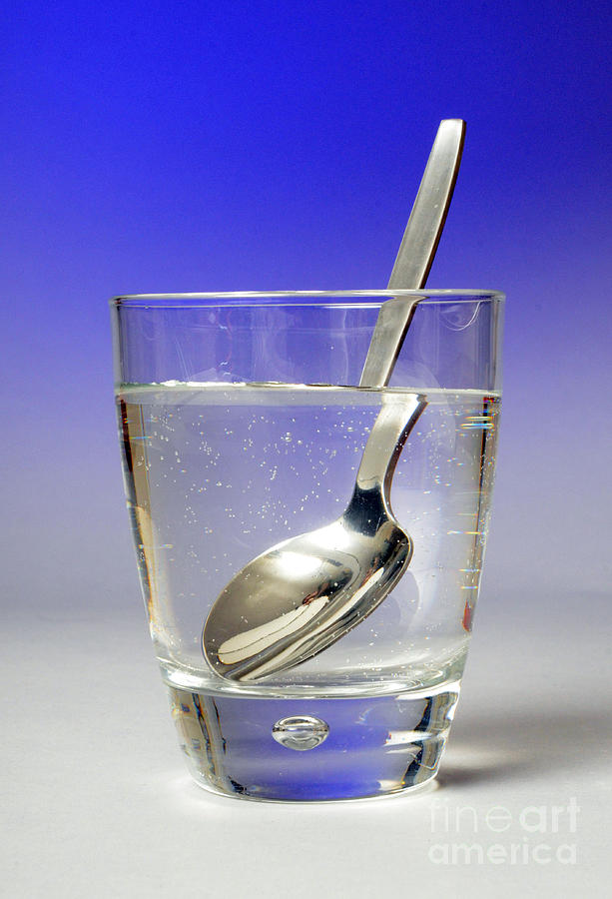
Whys does this spoon appear broken?

Slide 4
Refraction of Light
Lesson aims:
To be able to define refraction.
To be able to explain refraction using slowing down and speeding up.
To investigate refraction of light.

Slide 5
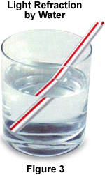
Refraction
Refraction is the bending of light as it moves through different substances.
Why does this occur?

Slide 6

Why is light refracted?
The speed of light depends on the material through which the light is travelling. When light enters a different material (e.g. when moving from air into glass), the speed of light changes.
This causes the light to bend or refract.
air
glass
The speed of light is affected by the density of the material through which it is travelling.
The speed of light is affected by the density of the material through which it is travelling.
When light enters a more dense medium, its speed decreases and this is why refraction occurs.

Slide 7
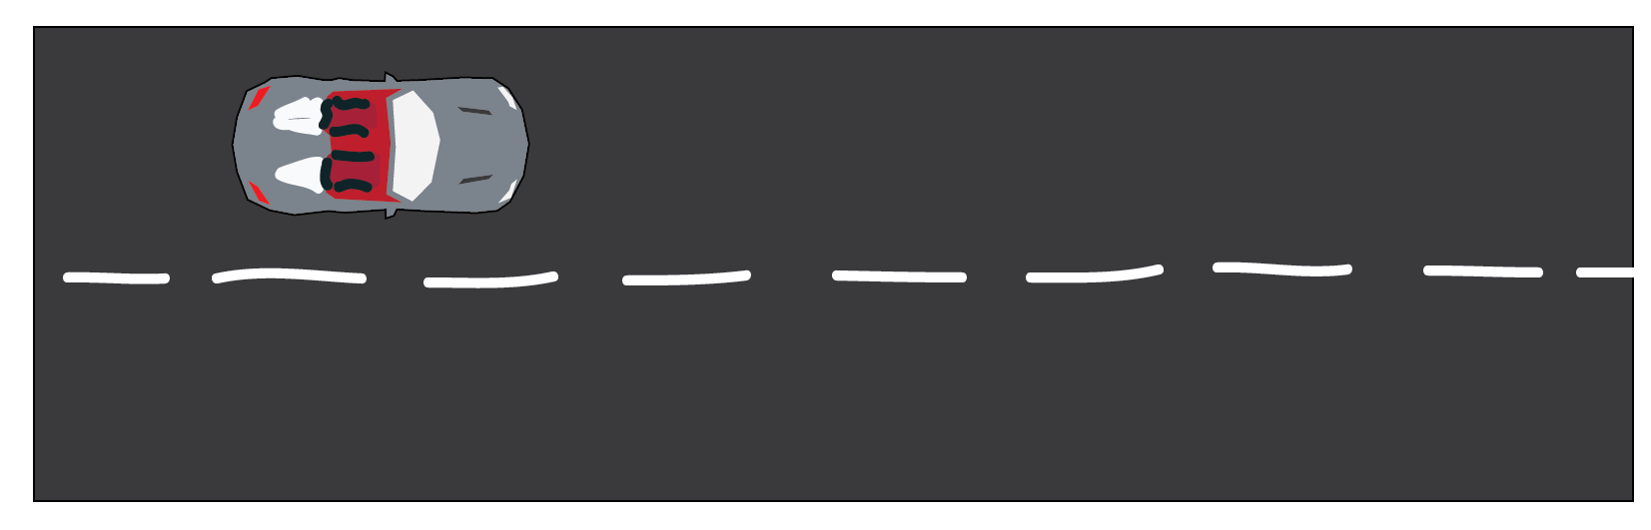
Refraction of light
AN ANALOGY…
A car travelling a long the road.

Slide 8
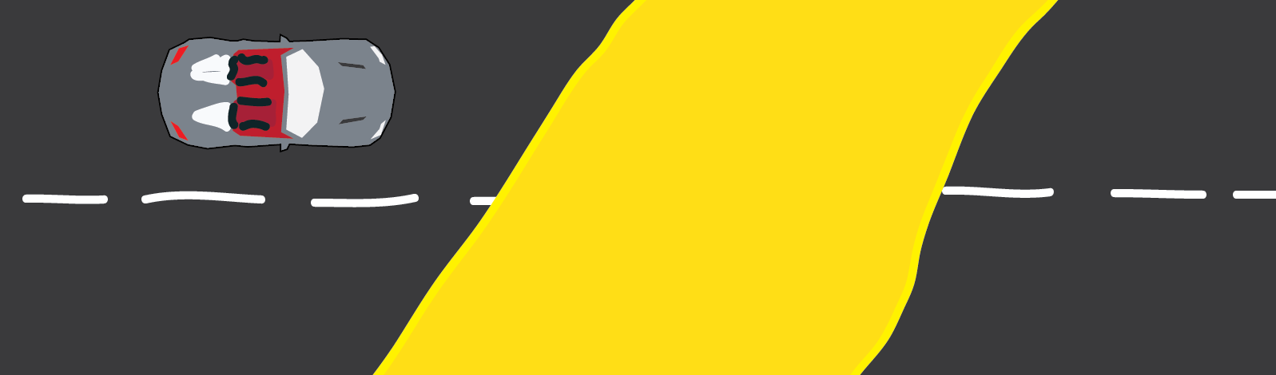
It comes to a sandy patch of road!!
Which wheel is going to hit the sand first?

Slide 9
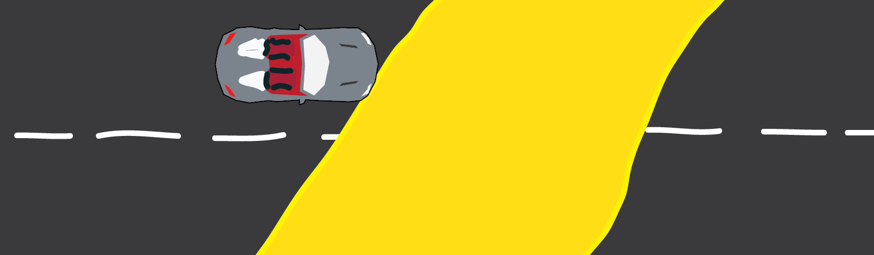
The front right wheel will meet the sand first.
What will happen to that wheel??

Slide 10
It will spin!!
It cannot grip the road anymore…
What can you tell me about the speed of the two front wheels?

Slide 11
The left wheel is now going faster than the right.

Slide 12
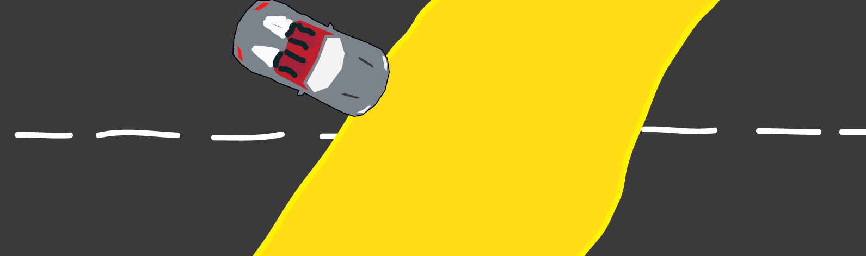
Because the left wheel is going faster…
The car turns round to the right!

Slide 13
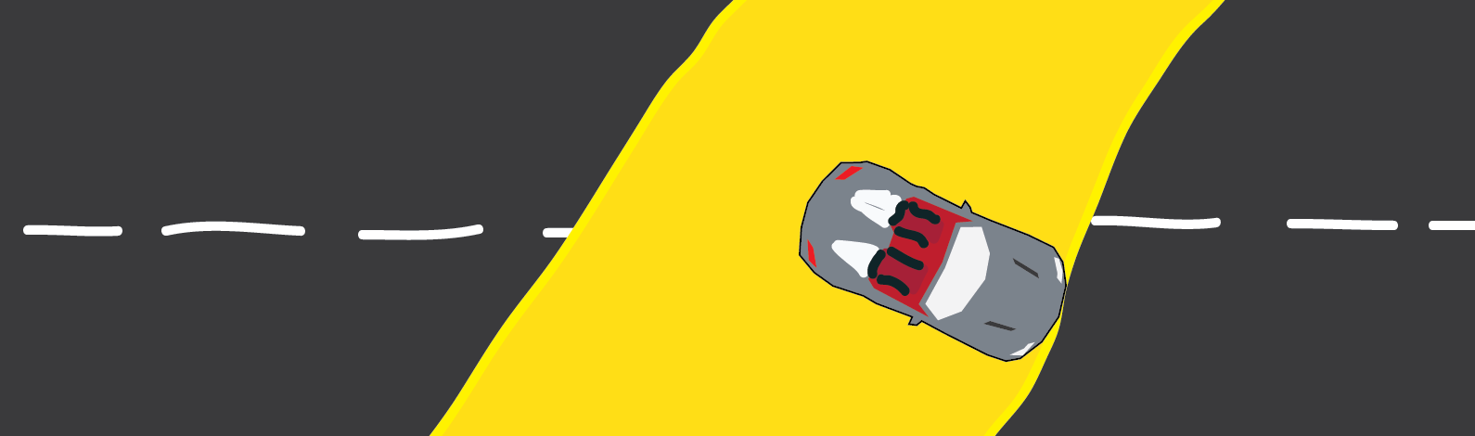
Now the front wheels are on the sand, the car goes in a straight line.

Slide 14
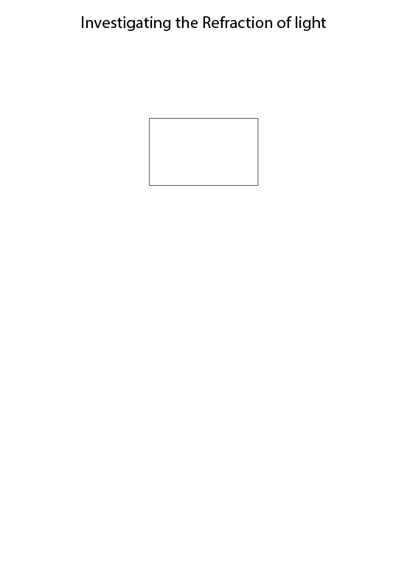
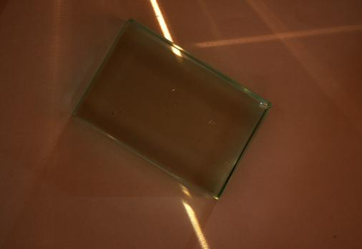
How to draw light ray diagrams to measure refraction
1. Place a rectangular glass block on a sheet of paper and trace around it.

Slide 15
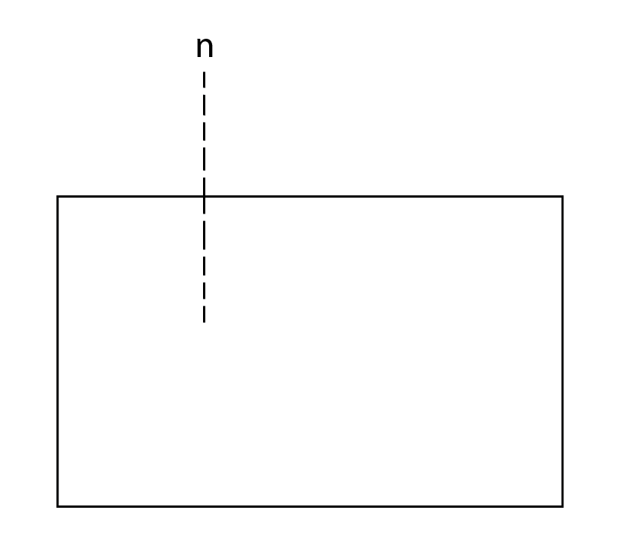
Refraction of Light Investigation
2. Draw your normal as a perpendicular (at right angles or 90∘ ) dotted line onto the top edge of the glass block.

Slide 16
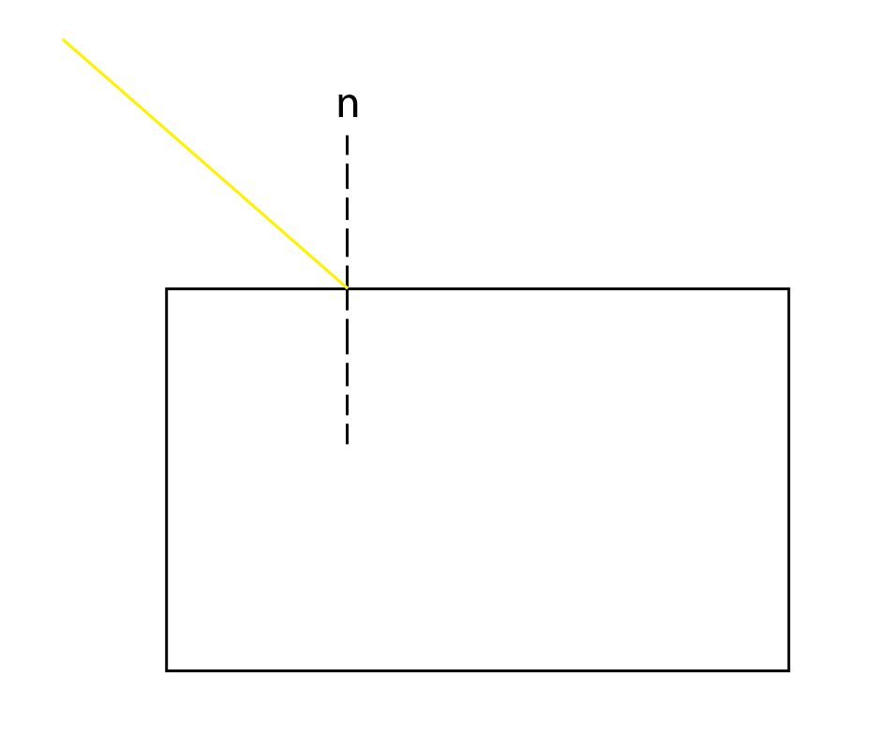
3. Shine your single beam at the point where the normal and the glass meet.
(The prism must be on the paper too… 😐)
4. Now, mark with a dot:
the start point of the light
where the light comes out of the glass
About 5 cm further on from the glass.

Slide 17
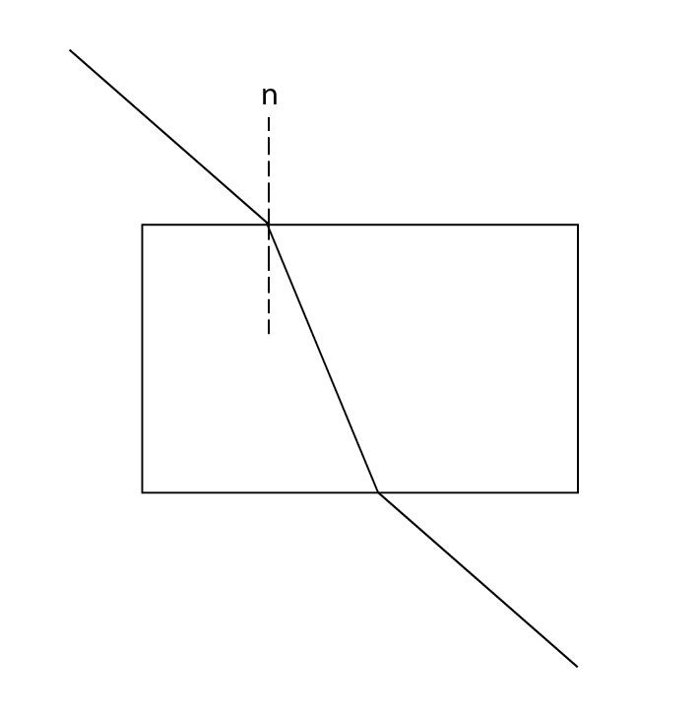
5. Connect the dots
6. Then add the arrows, showing the direction of the light.

Slide 18
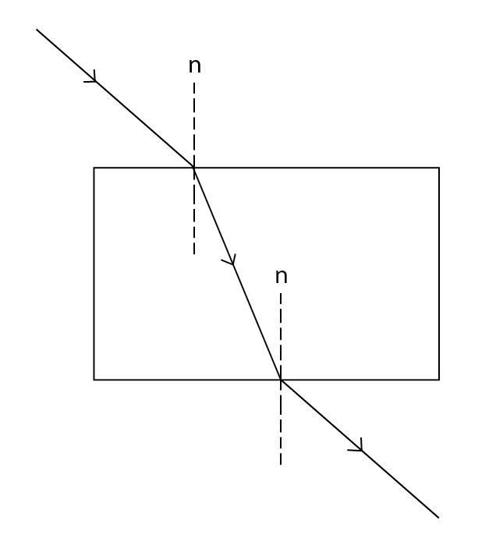
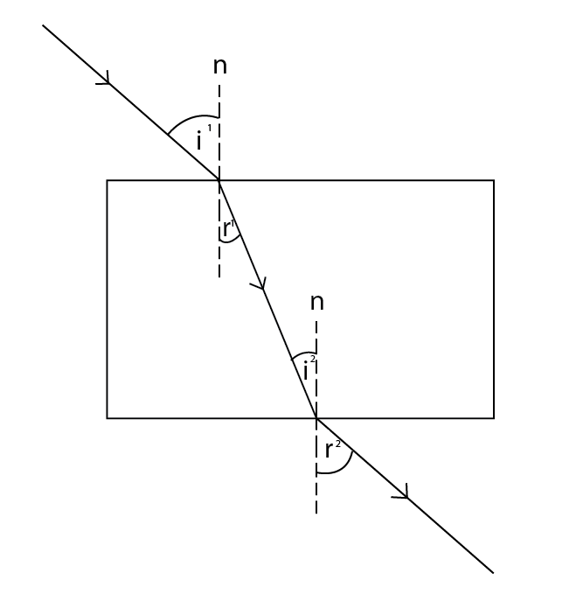
7. Draw a second normal, where the light exits the glass and label the angles as shown

Slide 19
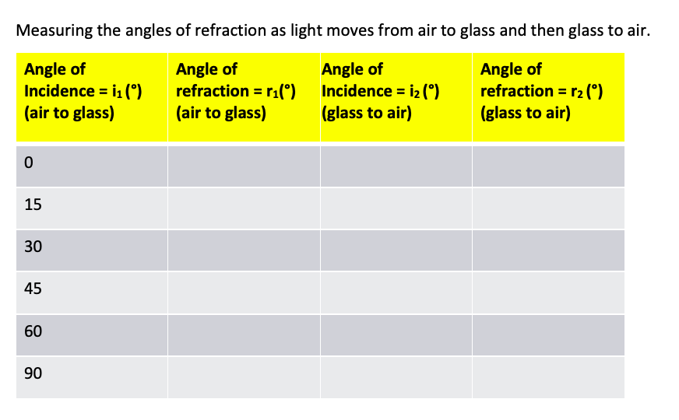
Refraction Investigation – 30 mins
Copy the table below into your book.
Trace the glass onto a sheet of white paper and then trace the rays that are formed and measure the angles.

Slide 20
What do you notice?
i¹ = r²
i² = r¹
WOW!!!

Slide 21
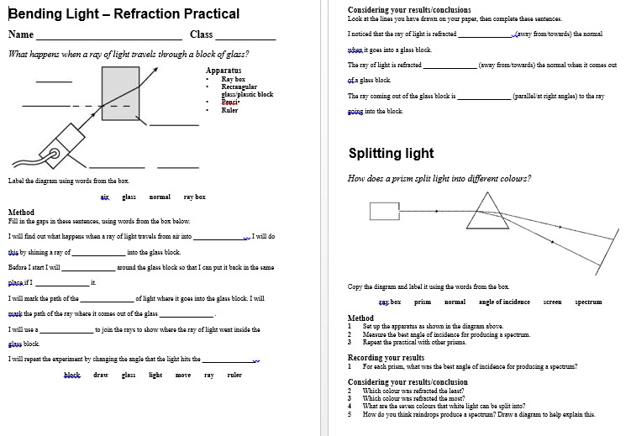
Complete worksheets

Slide 22
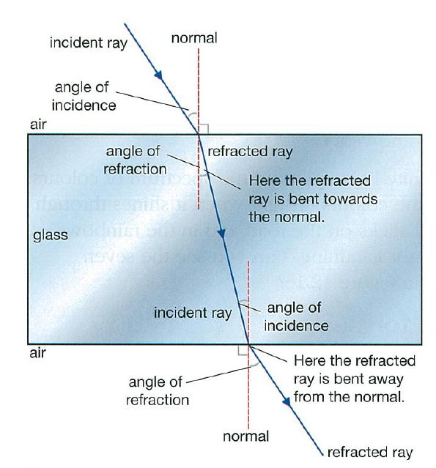
Why does the light refract towards the normal when travelling from air to glass?
Why does the light refract away from the normal when travelling from glass to air?

Slide 23
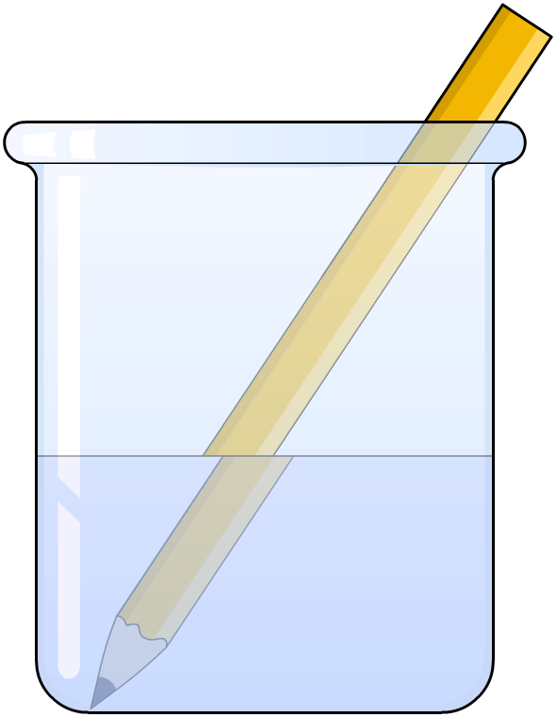
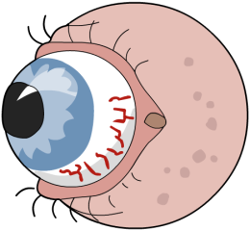
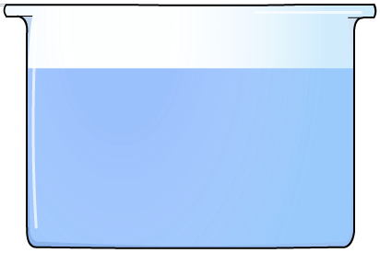

Effects of refraction
Light from the part of the pencil in the water is refracted as it travels from the water into the air, making it appear bent.
How does refraction make this stone look closer to the surface of the water than it really is?
Light rays from the stone are refracted as they leave the water.
The brain assumes the rays have travelled in straight lines, and is fooled into forming an image where it thinks the light rays came from.

Slide 24
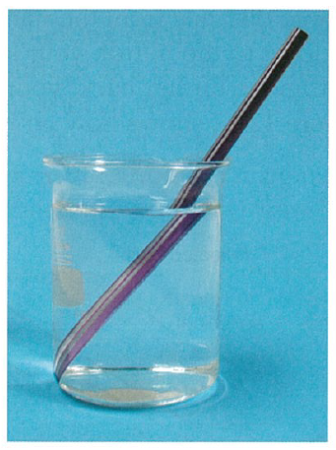
Explain this:
Light travelling from the
pencil bends when it leaves
the water, and so it look like
the pencil is in two different
positions.

Slide 25
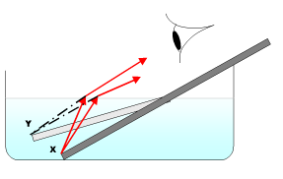
Explained…
Light bends away from the normal when entering a less dense substance (eg. water to air).
This is because the speed of light speeds up when moving from water to air.

Slide 26
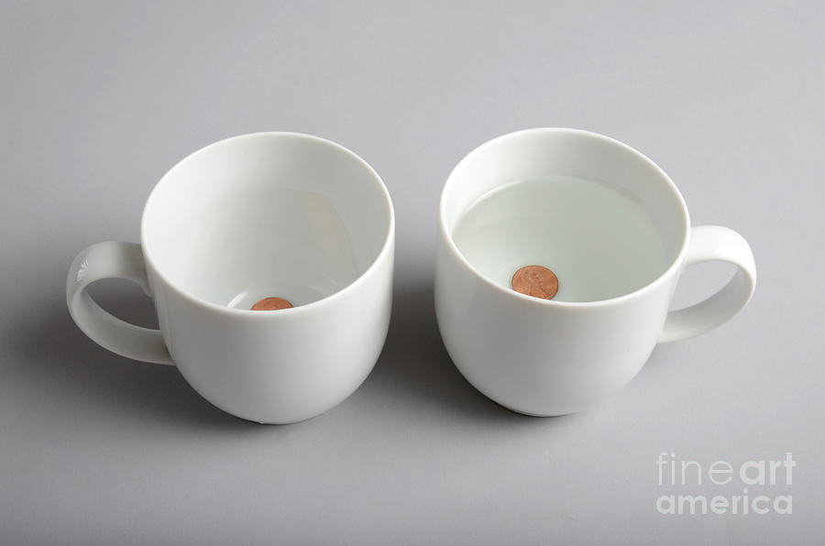
Floating coin trick….

Slide 27
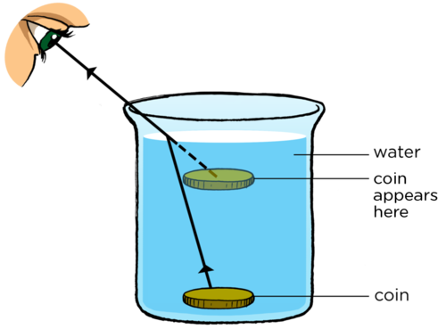
The coin appears to be floating…

Slide 28
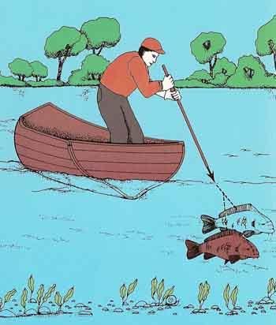
Why is it difficult to spear a fish from a boat?
As the speed of light speeds up moving from water to air, the light bends away from the normal, so the fish appears closer to the surface.

Slide 29
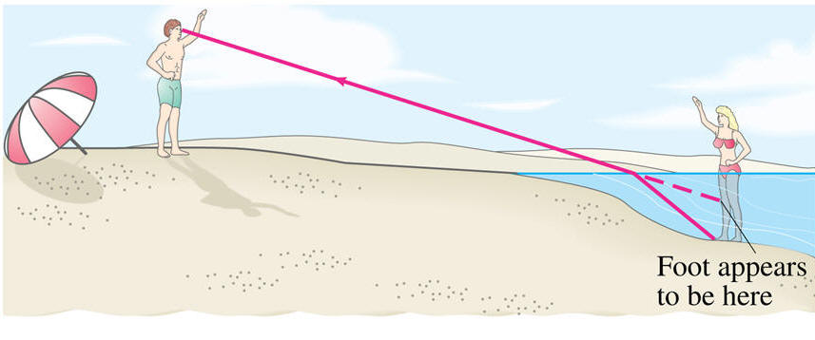
Her legs look short because the light from her feet bends when it moves from water to air!

